Slide 1

Lecture #1

Slide 2
Operating system by Saima Kanwal
Lecture # 1

Slide 3
Marks Distribution
Internal Assessment: 35 Marks
Mid Semester Examination: 25 Marks
Final Semester Examination: 40 Marks

Slide 4
Rules to Remember
Come to class prepared to learn.
Keep your mobiles Silent and keep it inside your bag.
Late arrival in my class will be marked Absent
Raise your hand before speaking or leaving your seat.
Listen and follow directions.
Actively participate in classroom activities
Ask Questions.
Convey your issue to your instructor through your CR.

Slide 5
Rules for Assignments
No extensions will be granted for submission of assignments.
Once deadline is over, no assignment will be accepted.
Plagiarism will be checked for each assignment (Where Applicable).

Slide 6
Operating System
Background

Slide 7

Four Components of a Computer System

Slide 8
Overview
A computer system has many resources (hardware and software), which may be require to complete a task.
The commonly required resources are input/output devices, memory, file storage space, CPU etc.
Software also plays a vital role in a computer system
Application Software
System Software

Slide 9
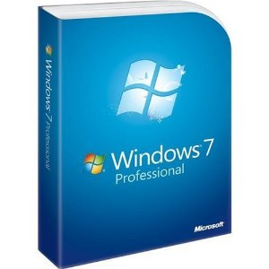
What is Operating System?
A program that acts as an intermediary between a user of a computer and the computer hardware
All computers and computer-like devices have operating systems, including your laptop, tablet, desktop, Smartphone, smart watch, router
Homework: Watch the following video
https://www.youtube.com/watch?v=fkGCLIQx1MI

Slide 10
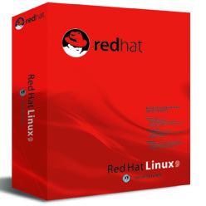
Operating System
In technical terms, operating system is the resource manager i.e. it can manage the resource of a computer system internally.
The resources are; processor, memory, storage, I/O Devices, files etc.

Slide 11
Computer-System Organization
A modern computer system consists of one or more CPUs and multiple device controllers, all connected via a common bus to shared memory. Each device controller manages a specific type of device (e.g., disk drives, audio, video). The CPU and controllers operate in parallel, with a memory controller ensuring synchronized access.
When powered on or rebooted, the system runs a bootstrap program stored in ROM or EEPROM (firmware). This program initializes the system, sets up hardware components, and loads the operating system for execution. For completing this goal, the bootstrap program must locate the operating-system kernel and load it into memory.

Slide 12
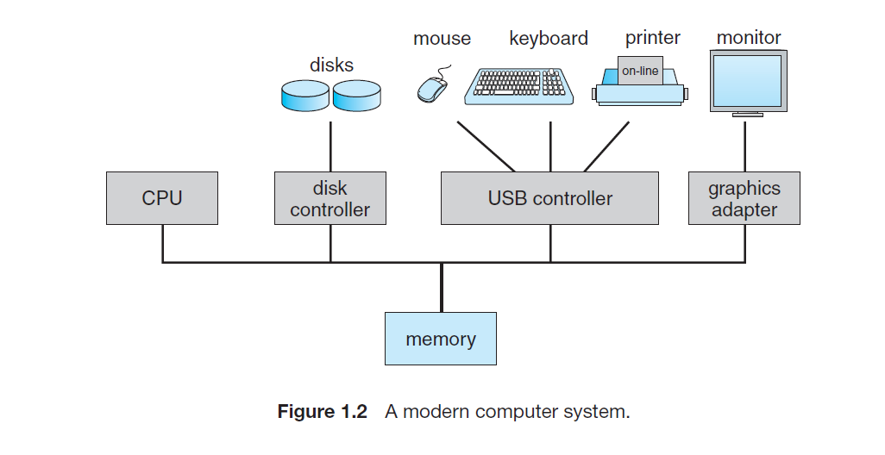

Slide 13
System Boot and Interrupts
After loading, the kernel starts system processes (daemons) to provide services. On UNIX, the "init" process launches other daemons. Once booted, the system waits for events, usually triggered by interrupts from hardware or software.
Hardware interrupts come via the system bus, while software interrupts occur through system calls. When interrupted, the CPU pauses execution, jumps to an interrupt service routine (ISR) via an interrupt vector table, processes the request, then resumes the previous task.
Modern systems store the return address on the system stack. If the ISR modifies processor state, it must save and restore it before returning to ensure smooth execution.

Slide 14
Storage Structure
The CPU can only execute instructions from main memory (RAM), typically DRAM. General-purpose computers store programs in rewritable memory, while ROM and EEPROM store static programs like the bootstrap program.
Memory consists of bytes with unique addresses, accessed via load and store instructions. The CPU loads data from memory into registers and stores data back when needed. It also automatically fetches instructions from memory for execution.

Slide 15
A computer’s instruction-execution cycle fetches, decodes, and executes instructions, storing results in memory. Main memory is limited and volatile, so secondary storage (like magnetic disks) is used for permanent data storage. Storage systems vary in speed, cost, size, and volatility, including registers, cache, RAM, disks, and CDs. Efficient storage management is crucial for system performance.

Slide 16
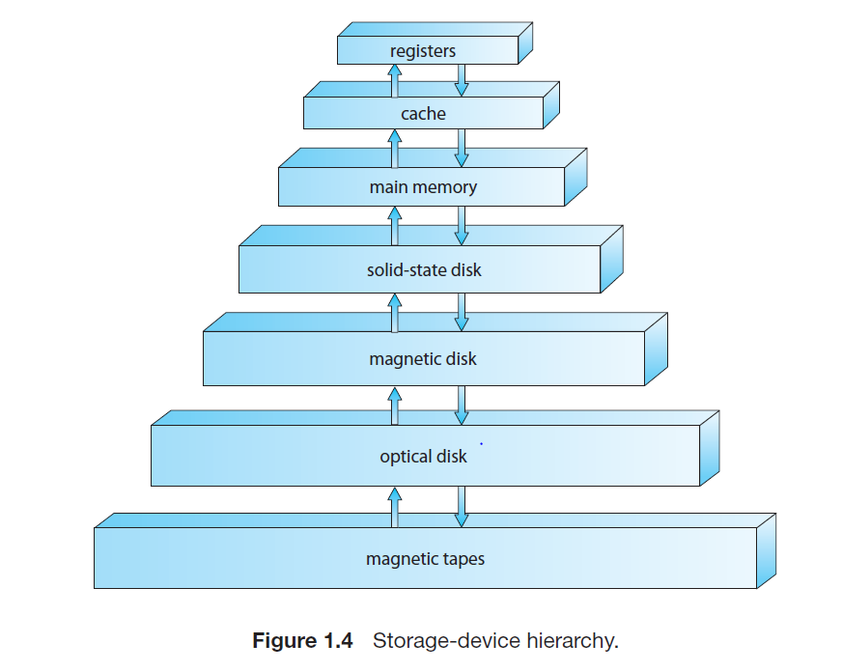

Slide 17
Storage systems are organized in a hierarchy based on speed and cost. Faster storage (e.g., registers and cache) is more expensive and volatile, while slower storage (e.g., magnetic disks and tapes) is cheaper and nonvolatile. Solid-state drives (SSDs) are faster than magnetic disks and nonvolatile. Flash memory and NVRAM provide nonvolatile storage, with flash being slower than DRAM and NVRAM using batteries for backup power. The hierarchy balances speed, cost, and reliability.

Slide 18
I/O Structure
I/O devices in a computer are managed by device controllers and device drivers. Controllers handle specific devices and transfer data to their local buffers, while drivers provide a standard interface for the operating system.
For I/O operations, the driver sets up the controller, which performs the data transfer. The controller signals completion via an interrupt. For large data transfers, Direct Memory Access (DMA) allows controllers to transfer entire blocks of data directly to or from memory with minimal CPU involvement, reducing overhead and improving efficiency.

Slide 19
Computer System Structure
Computer system can be divided into four components:
Hardware – provides basic computing resources
CPU, memory, I/O devices
Operating system
Controls and coordinates use of hardware among various applications and users
Application programs – define the ways in which the system resources are used to solve the computing problems of the users
Word processors, compilers, web browsers, database systems, video games
Users
People, machines, other computers

Slide 20
Four Components of a Computer System

Slide 21
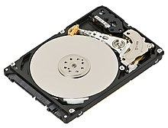
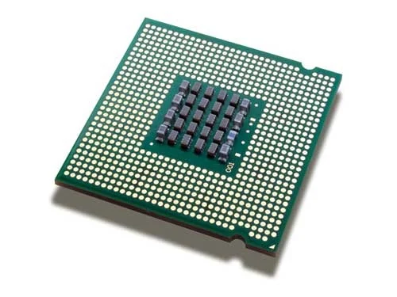
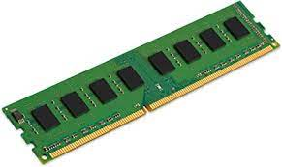
Hard Disk
RAM
Processor

Slide 22
Basic components of a CPU
Program Counter (PC)
Holds the memory address of the next instruction
Instruction Register (IR)
holds the instruction currently being executed
General Registers (Reg. 1..n)
hold variables and temporary results
Arithmetic and Logic Unit (ALU)
performs arithmetic functions and logic operations

Slide 23
Stack Pointer (SP)
holds memory address of a stack with a frame for each active procedure’s parameters & local variables
Processor Status Word (PSW)
contains various control bits including the mode bit which determines whether privileged instructions can be executed
Memory Address Register (MAR)
contains address of memory to be loaded from/stored to
Memory Data Register (MDR)
contains memory data loaded or to be stored

Slide 24
Two Views of Operating System
User's View
System View

Slide 25
Operating System: User View
The user view of the computer refers to the interface being used.
Such systems are designed for one user to monopolize its resources, to maximize the work that the user is performing.
In these cases, the operating system is designed mostly for ease of use, with some attention paid to performance, and none paid to resource utilization.

Slide 26
Operating System: System View
Operating system can be viewed as a resource allocator also.
A computer system consists of many resources like - hardware and software - that must be managed efficiently.
The operating system acts as the manager of the resources, decides between conflicting requests, controls execution of programs etc.

Slide 27
What Operating Systems Do
Depends on the point of view
Users want convenience, ease of use and good performance
Don’t care about resource utilization
But shared computer such as mainframe or minicomputer must keep all users happy
Users of dedicate systems such as workstations have dedicated resources but frequently use shared resources from servers
Handheld computers are resource poor, optimized for usability and battery life
Some computers have little or no user interface, such as embedded computers in devices and automobiles

